Slide 1
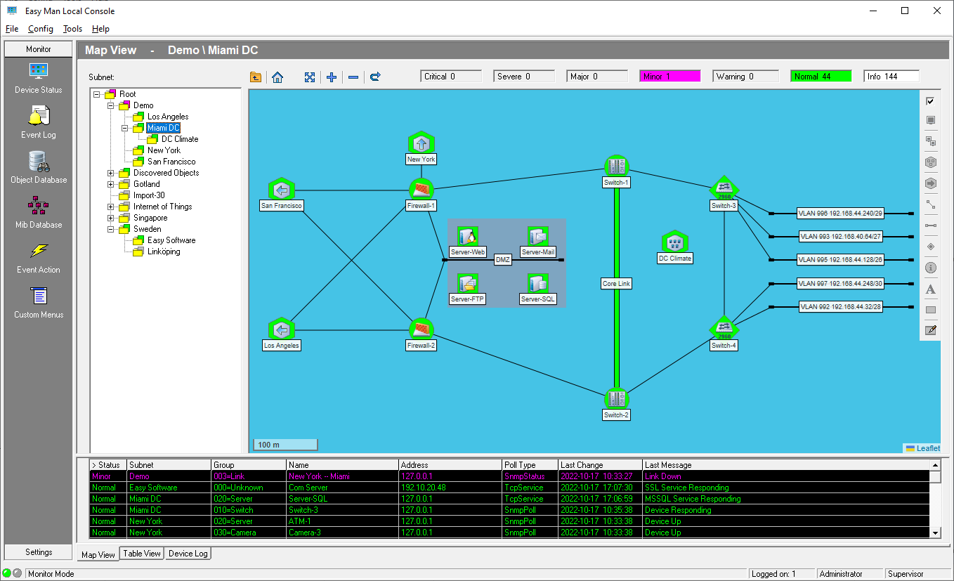
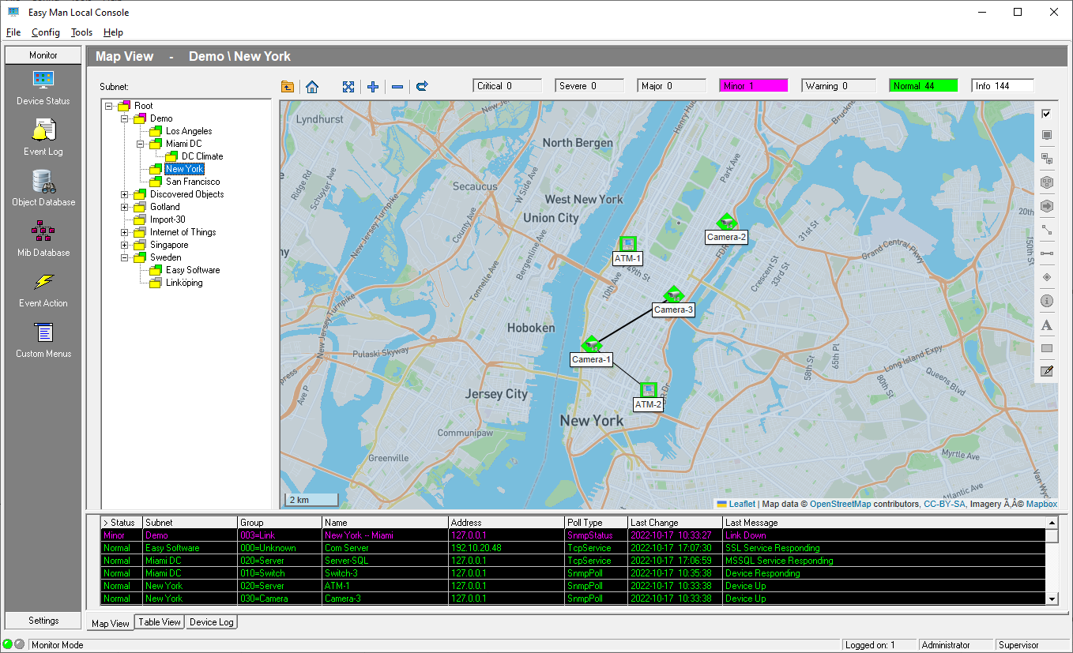
Easy Man Network Manager
With Easy Man you can: Visualize and monitor your network infrastructure. Draw and show how your devices are connected, their geographic location and status. Present status and alarms in a flexible and user friendly way.
Key Features: Overview- good overview of device status and alarms. Event Tracing - fast and easy tracing of events. Consoles - 25 concurrent consoles (local and remote) User Account - 3 user levels (Supervisor, Operator, Observer) Restricted View - restricted user views. Polling - icmp, snmp, tcp and custom polls. External Alarm - push or mail via Easy Look. MS SQL - Express 2019 bundled. Import - map database from SNMPc. Maps - OpenStreet Map for geographic presentation

Slide 2

Workgroup / Enterprise Edition:
 | Workgroup | Enterprise | Enterprise+ | Enterprise++
Map Objects | 10,000 | 10,000 | 10,000 | 10,000
Polled Devices | 100 | 1,000 | 1,500 | 3,000
Requirements:
 | CPU | Memory | Disk | OS
Server | 2 GHz | 12 GB RAM | 10 GB | Win 2019/2022
Remote Console |  |  |  | Win 10/11
Easy Software AB
Strandvägen 96, 791 43 Falun, Sweden
www.easysoft.se

